Slide 1


B.Tech Computer Science and Engineering – Vth Semester
Theory Of Computation
Department of Computer Science and Engineering

Slide 2
Theorem: if two states are not distinguished by the table filling algorithm then the states are equivalent
Suppose the theorem is false then there exists a pair of states {p,q} such that
States p and q are distinguishable, which means there is some string w such that exactly one δ*(p,w) and δ*(q,w) is accepting and yet
The table filling algorithm does not find p and q as distinguishable.
We call such pair as bad pair

Slide 3
Theorem
If there are bad pairs, then there are various strings with various lengths will distinguish them. We will consider the shortest of them.
Let ‘w’ be the shortest string that distinguishes p and q.
W=a1a2…an and δ*(p,w) and δ*(q,w) exactly one is accepting
Consider the states r= δ(p,a1) s= δ(q,a1)
Now observe that states r and s are distinguishable because
δ*(r,a2a3..an) = δ*(p,w)
δ*(s,a2a3..an) = δ*(q,w)
Initially we have assumed p and q are distinguishable so definitely r and s are distinguishable .
But the inductive part of the table filling algorithm does not stop until it infers p and q are distinguishable. Here it contradicts with out assumptions hence the theorem is proved.

Slide 4
Testing Equivalency of Regular Languages
Through table filling algorithm we can easily check the equivalency of two DFAs.
if we want to verify two regular languages for its equivalency one by ER and one by NFA
Convert them both to DFA say L and M.
Now imagine one DFA with union of states from L and M.
That DFA will have two starting states.
Make any one of those two start states as the start state of the new combined DFA.
Now test the equivalence of the two starting state if they are equal then L=M

Slide 5
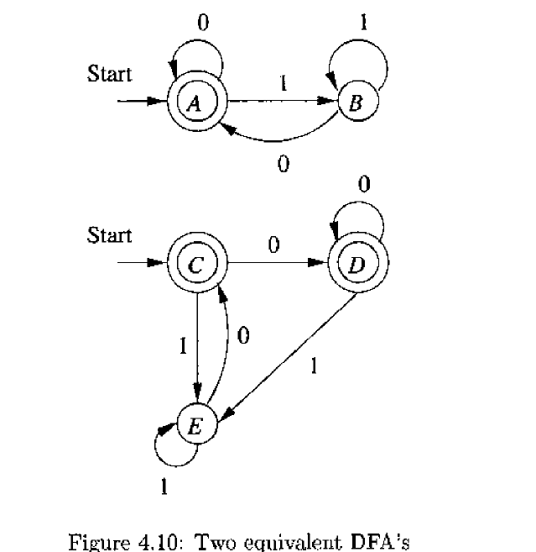
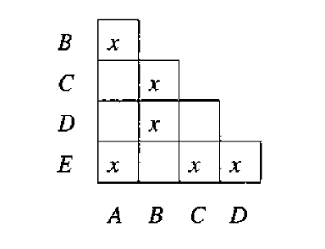
Testing Equivalency of Regular Languages ==ε+(0+1)*0

Slide 6
Testing Equivalency of Regular Languages ==ε+(0+1)*0
Here states
{AC}, {AD},{CD},{BE} are equivalent.
Hence by deducing the starting states A and C as equivalent we can say both the DFA s are equivalent.

